Slide 1
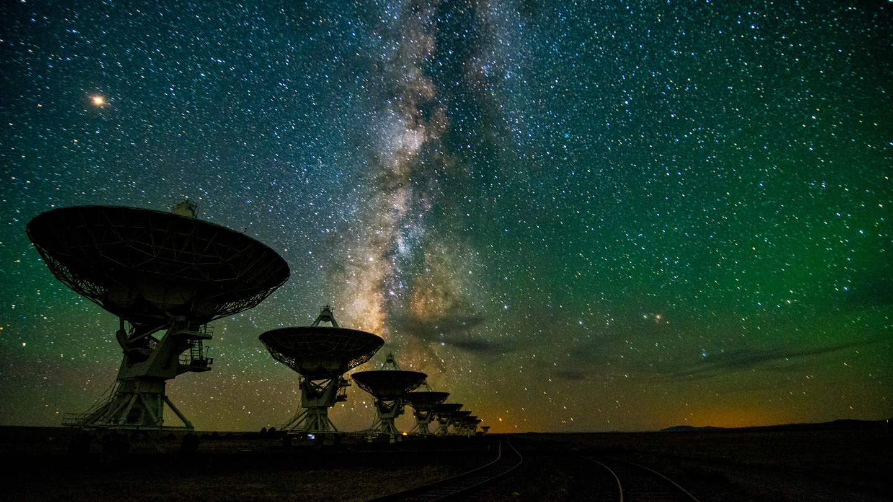
Dark Skies in New Mexico
Jon Holtzman
(NM DarkSky ; New Mexico State University)

Slide 2
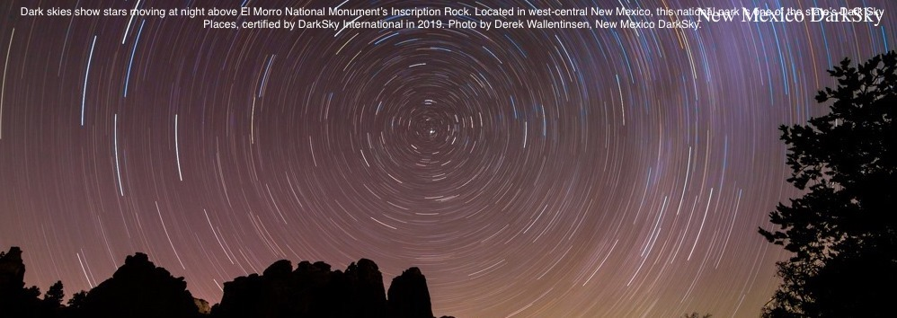
An amazing New Mexico resource: dark skies

Slide 3
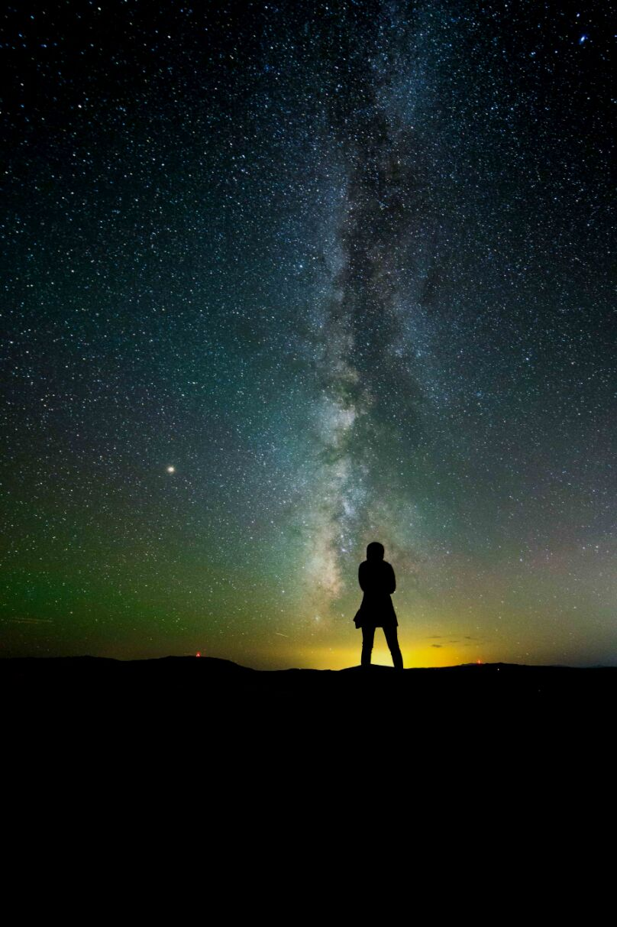
IN NM, WE ARE LUCKY!
ONLY 2 OUT OF 10 PEOPLE ON EARTH CAN SEE THE MILKY WAY
99% OF THE USA AND EUROPE LIVE UNDER LIGHT POLLUTED SKIES
MANY MAY ONLY SEE A HANDFUL OF STARS
IN NM, WE ARE LUCKY! …… FOR NOW
DarkSky International | 2024
Notes:
So, have you had the experience of being under a truly natural dark night sky?
Who here has seen the milky way? Who thinks they have to drive the farthest to see it?
Unfortunately, today only 1 in 10 people in the world live under skies that reach the level of natural darkness.

Slide 4
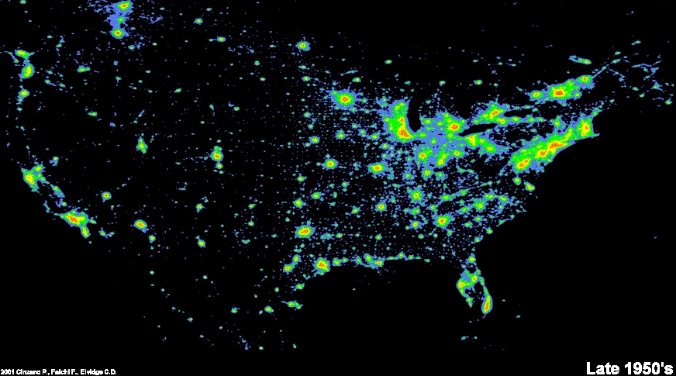
Light pollution is increasing at 9.6% per year*
*Per GloberatNight.org 2023 report
Notes:
Light pollution has been increasing rapidly! These images show the progression of artificial light at night as seen from space from the late 1950s to the present day. It’s not hard to imagine a world without any remaining natural darkness, at all, if we continue at our current rate.

Slide 5
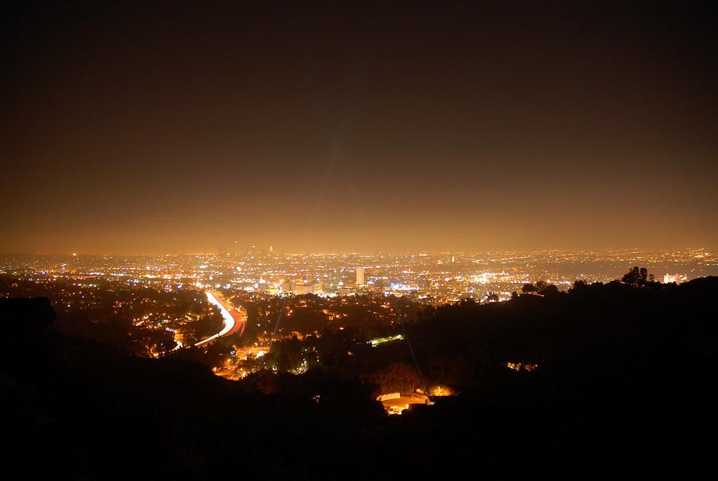
WHAT IS LIGHT POLLUTION?
Any adverse effect on humans or other animals from artificial light at night.
Can take several different forms
Image: Mike Knell
DarkSky International | 2024
Notes:
What is light pollution? Any adverse effect on humans or other animals from artificial light at night.
It comes in 3 main forms, Skyglow, Glare, and Light Trespass.

Slide 6
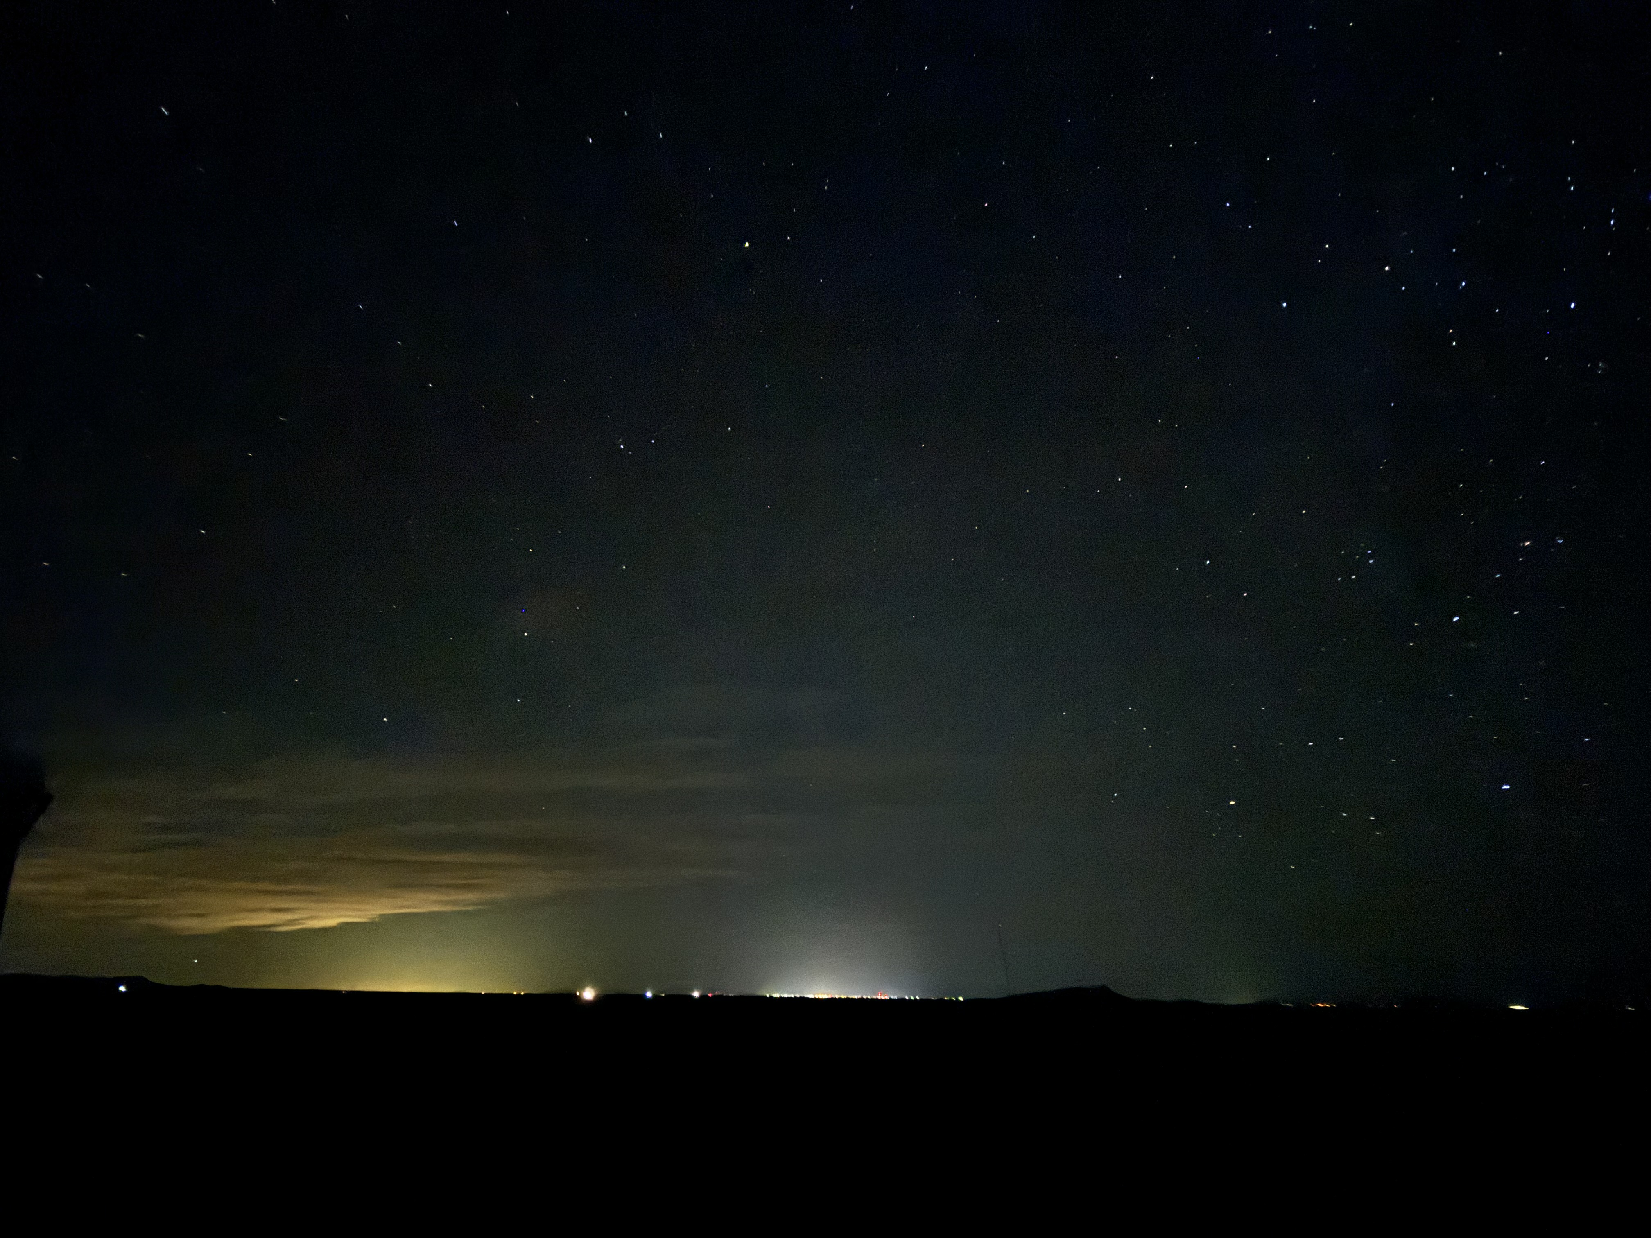
SKYGLOW
DarkSky International | 2024
Notes:
This photo was taken from the New Mexico Astronomy Village near Deming.
At the center is Deming from 22 miles away, and to the left is El Paso from 110 miles away.
You may ask “what’s the problem”? Well, without the sky glow, stars would be visible down to the horizon, and many MANY more stars would be seen in rest of the photo.

Slide 7
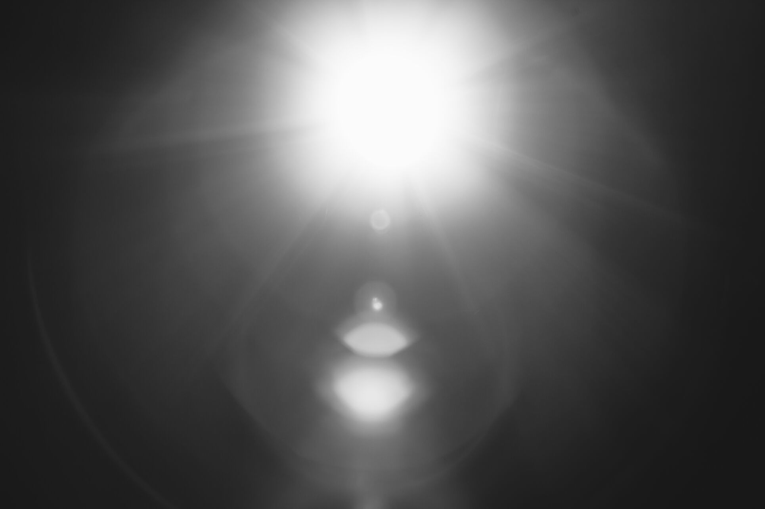
GLARE
DarkSky International | 2024
Notes:
We’ve all experienced glare from oncoming vehicles, bright unshielded floodlights, or a flashlight shined in our eyes. (Demo?)
Glare is when light enters our eyes at shallow angles, causing discomfort and restriction of the pupil, reducing visual acuity.
To make matters worse, commonly used LEDs are heavy in the blue/white light spectrum - causing even more impairment to our vision at night than historic light sources such as incandescent or high pressure sodium bulbs.

Slide 8
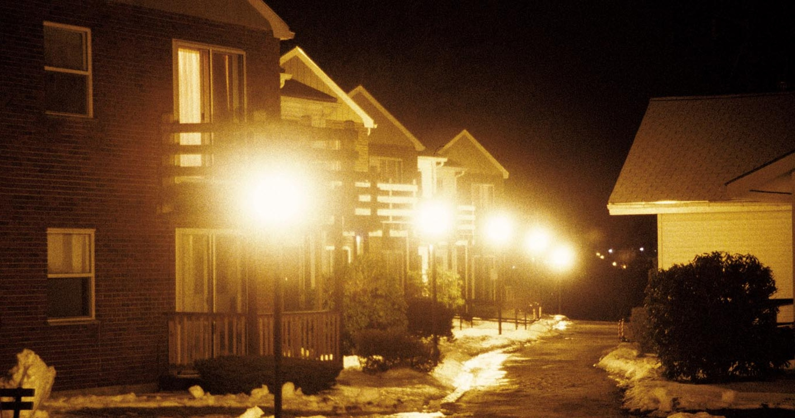
LIGHT TRESPASS
DarkSky International | 2024
Notes:
Light trespass occurs when light is falling outside of a property boundary onto another property or home.
Similar to noise, we can think of light trespass as a private property rights issue.
Trespass can also occur from street or parking lighting that is brighter than necessary, or unshielded.

Slide 9
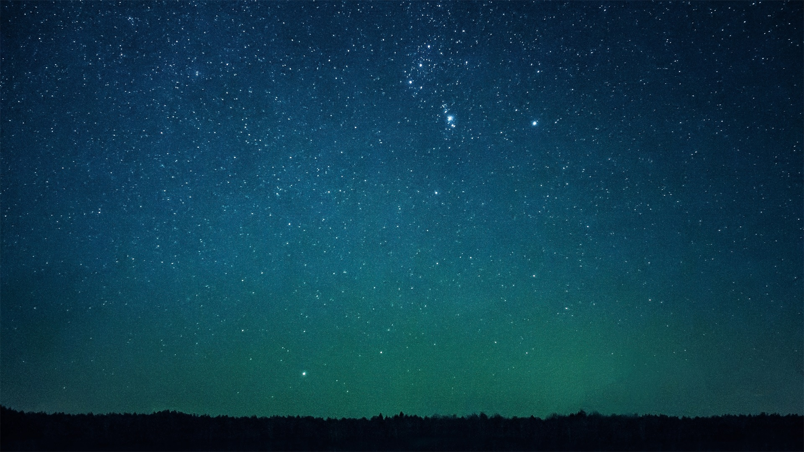
Why care about dark skies?
Cultural heritage and perspective on our location in the Universe
Ecological impacts : pollinators and migrating birds
Human safety and health
Energy and money savings
Science
Economic impact

Slide 10
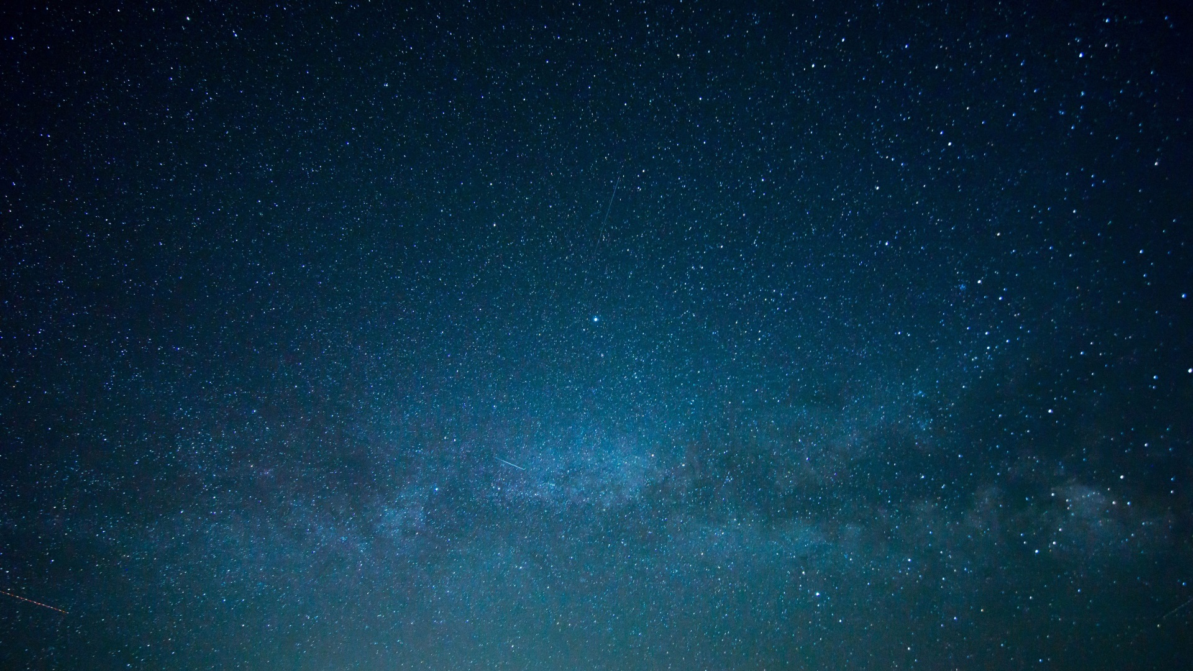
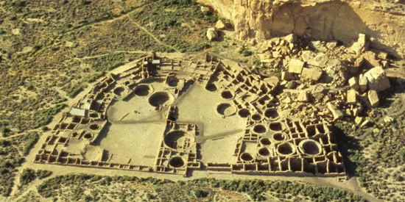
Cultural importance of dark skies : connections with nature
Dark skies have been an important component of different civilizations throughout human history
It is only very recently that we have lost them
In the modern world, some perspective on the Earth’s place in the cosmos is invaluable
For many people, seeing the Milky Way, or Saturn and its rings through a small telescope can be a life changing experience
Kids should know about the Milky Way by seeing it in the sky, not on a computer screen
Notes:
We’ve all experienced glare from oncoming vehicles, bright unshielded floodlights, or a flashlight shined in our eyes. (Demo?)
Glare is when light enters our eyes at shallow angles, causing discomfort and restriction of the pupil, reducing visual acuity.
To make matters worse, commonly used LEDs are heavy in the blue/white light spectrum - causing even more impairment to our vision at night than historic light sources such as incandescent or high pressure sodium bulbs.

Slide 11

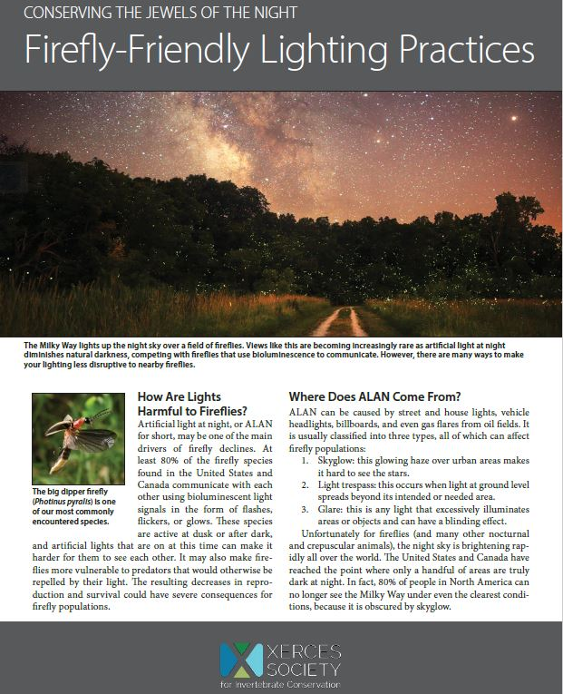
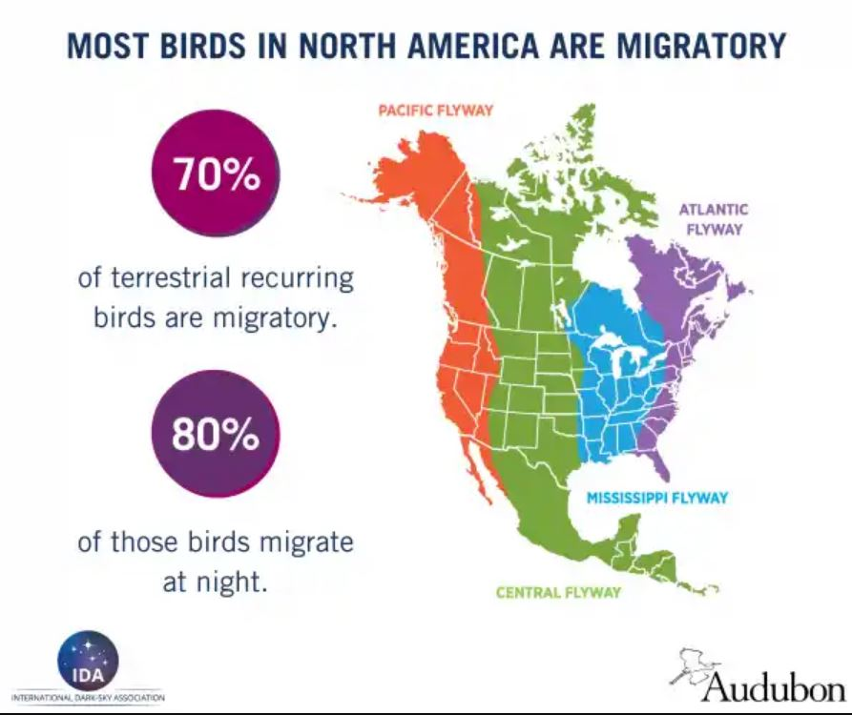
Ecological effects of light pollution
GLARE
DarkSky International | 2024
Notes:
We’ve all experienced glare from oncoming vehicles, bright unshielded floodlights, or a flashlight shined in our eyes. (Demo?)
Glare is when light enters our eyes at shallow angles, causing discomfort and restriction of the pupil, reducing visual acuity.
To make matters worse, commonly used LEDs are heavy in the blue/white light spectrum - causing even more impairment to our vision at night than historic light sources such as incandescent or high pressure sodium bulbs.

Slide 12

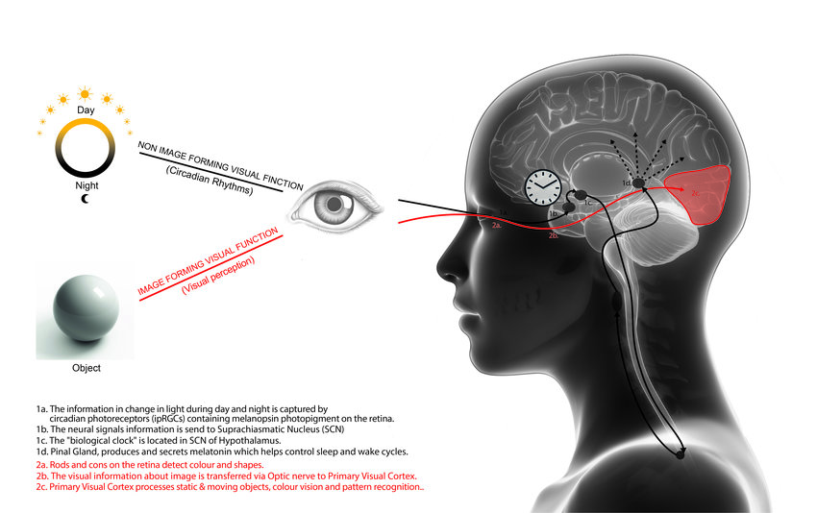
Human safety/health concerns related to lighting
Get a good night’s sleep!
Disability Glare results in decreased visual acuity and reduced driving visibility.
A 4000K LED is emitted as blue light that the human eye perceives as a harsh white color. Our pupils constrict, and we can’t see as well. A “veil of illuminance” leads to discomfort and reduced visibility.
Eye Damage: Blue wavelengths create more scattering of light in the human eye and potential damage to retinas.
Disruption of Circadian Rhythm via melatonin suppression (LEDs 5x).
Secondary negative health effects from chronic sleep disruption: increased risk of cancer, diabetes, cardiovascular disease, and obesity.
Zielinska-Dabkowska and Xaviab. 2018. An overview of cognitive and biological effects of city nightime illumination including a London case study.
DarkSky International | 2024
Notes:
In 2016, the AMA adopted guidance on the detrimental effects of LED street lights on human health.
I have noticed this myself. In my own neighborhood, people walk up and down the road at night with their dogs or for exercise. It is very difficult to see them when there is an oncoming car with LED headlights – even when not on bright lights.

Slide 13
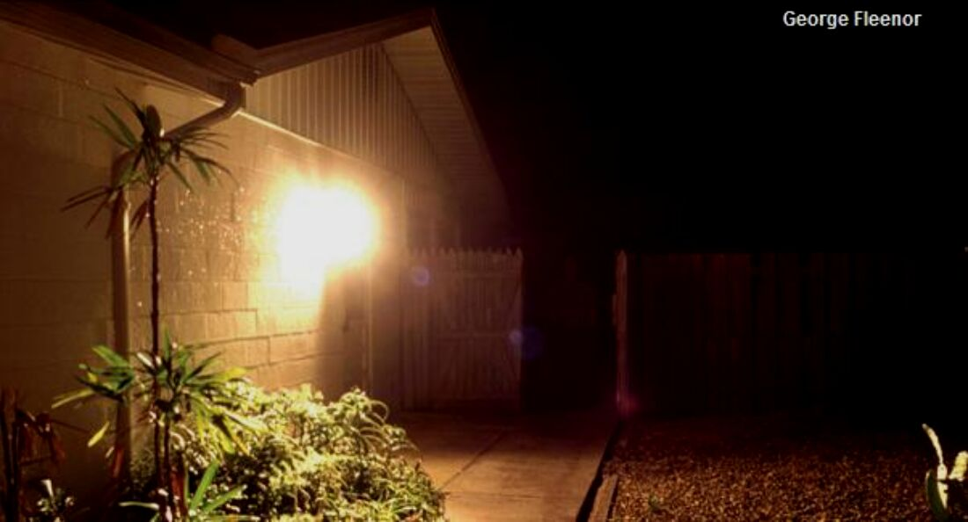
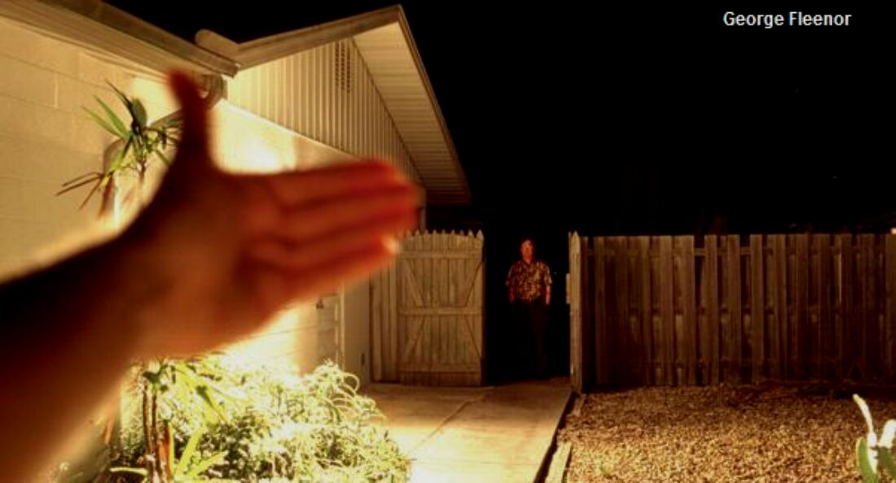
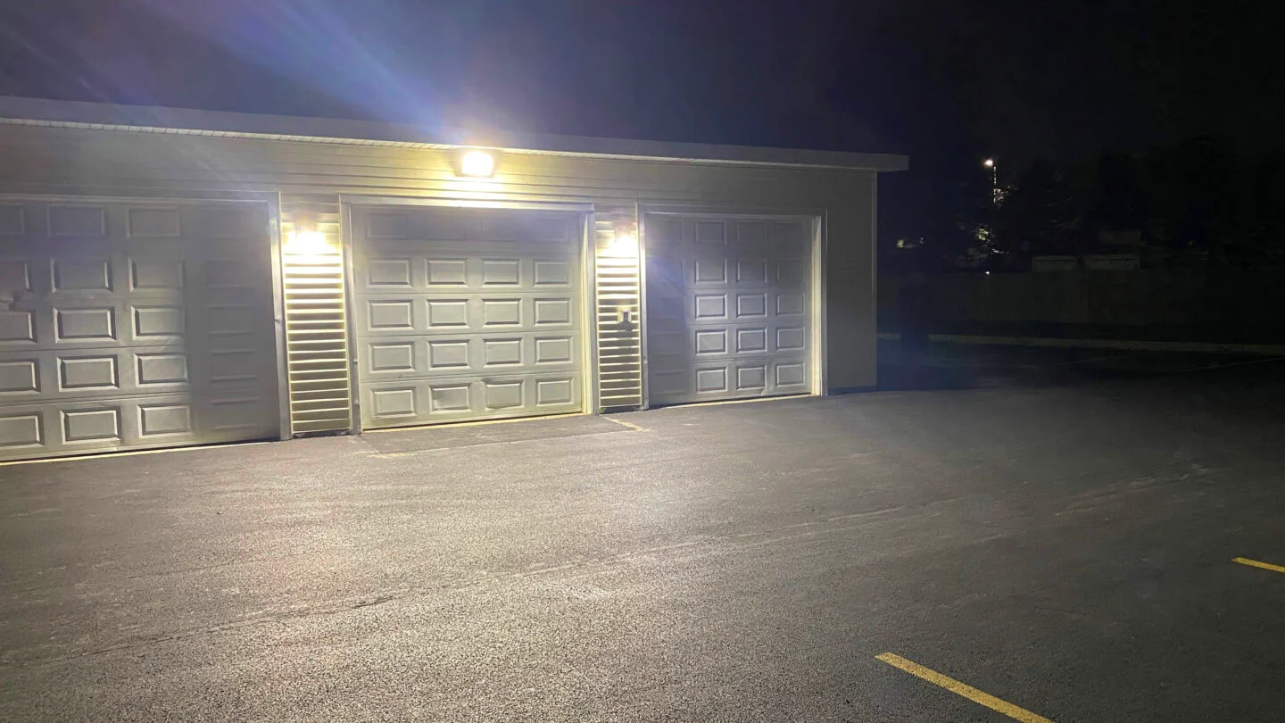
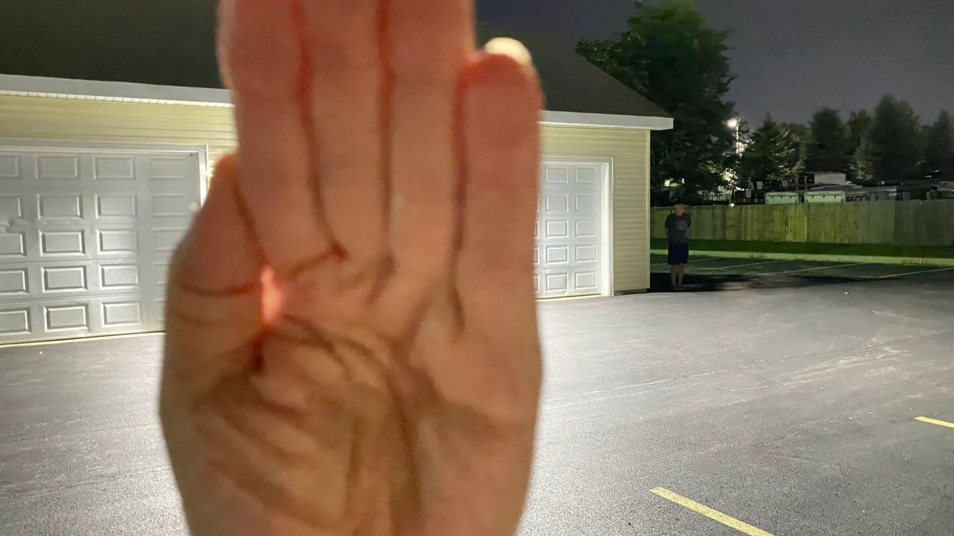
MYTH: MORE LIGHTING IS SAFER
REALITY: WELL DESIGNED LIGHTING IS SAFER
ELIMINATE GLARE
DarkSky International | 2024
Notes:
The wall pack mounted to this building is unshielded, causing unnecessary and uncomfortable glare. If you were exposed to this, your pupils would become restricted and your ability to see would be reduced.
This photo shows the improvement if the fixture was shielded. Your eyes aren’t assaulted, and you’re better able to see the intruder.

Slide 14
Lighting and safety
A 2015 study published in the Journal of Epidemiology and Community Health found that streetlights don’t prevent accidents or crime, but do cost a lot of money.
” A 1997 National Institute of Justice study concluded, “We can have very little confidence that improved lighting prevents crime.”
A Chicago Alley Lighting Project showed a correlation between brightly lit alleyways and increased crime.
Most property crime occurs in the light of the day. And some crimes like vandalism and graffiti actually thrive on night lighting.
Outdoor lighting is intended to enhance safety and security at night, but too much lighting can actually have the opposite effect. Visibility should always be the goal. Glare from bright, unshielded lights actually decreases safety because it shines into our eyes and constricts our pupils. This can not only be blinding, it also makes it more difficult for our eyes to adjust to low-light conditions.
Dark sky does not necessarily mean a dark ground. Smart lighting that directs light where it is needed creates a balance between safety and starlight.

Slide 15
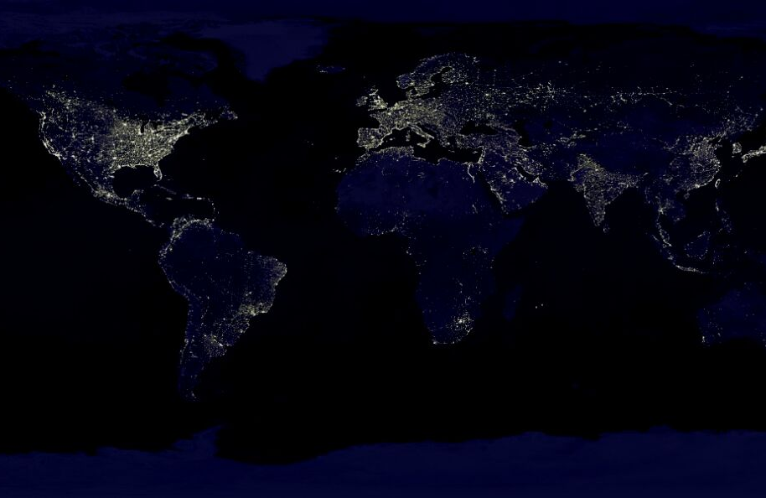
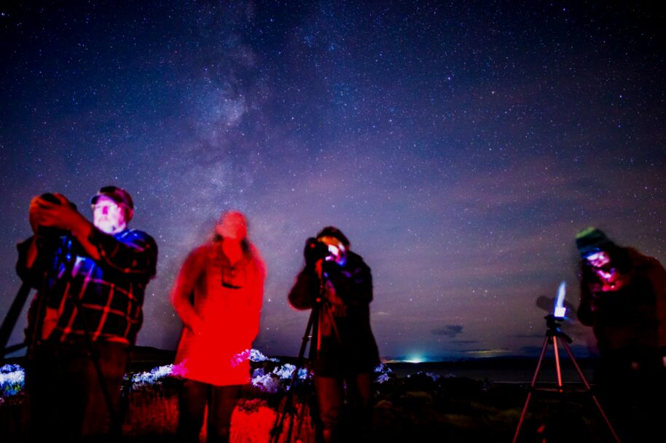
Light pollution wastes energy and money
3-7 BILLION DOLLARS
spent every year on unneeded lighting
21 MILLION TONS OF CO2
burned by unnecessary lighting
The International Dark-Sky Association | 2019
DarkSky International | 2024
Notes:
Light pollution is also a waste of money and energy. About 35% of lighting worldwide is wasted light, shooting up into the sky. When we do the math, we spend around 3-7 billion dollars a year on wasted light, while adding 21 million tons of Carbon Dioxide to the atmosphere each year.
Can we really afford to be doing this while we struggle to combat climate change?

Slide 16
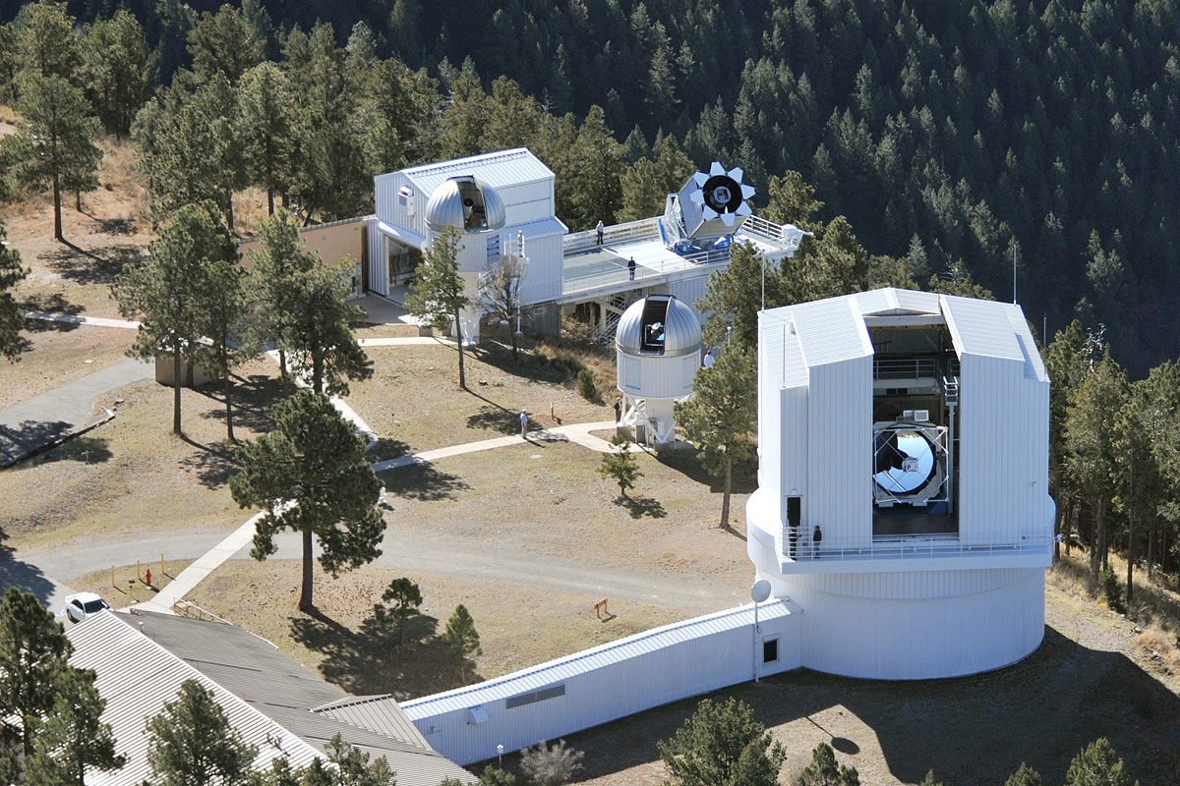
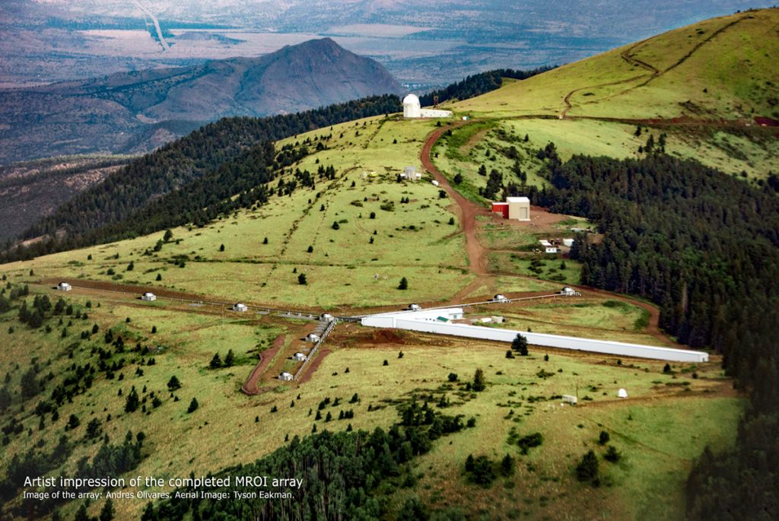
Science
New Mexico is home to several world class observatories associated with our Universities that are doing important science
Apache Point Observatory
Magdalena Ridge Observatory
(Very Large Array)
Not only do these observatories produce science, but they also attract students, bring visitors into the state, and employ dozens of people!

Slide 17
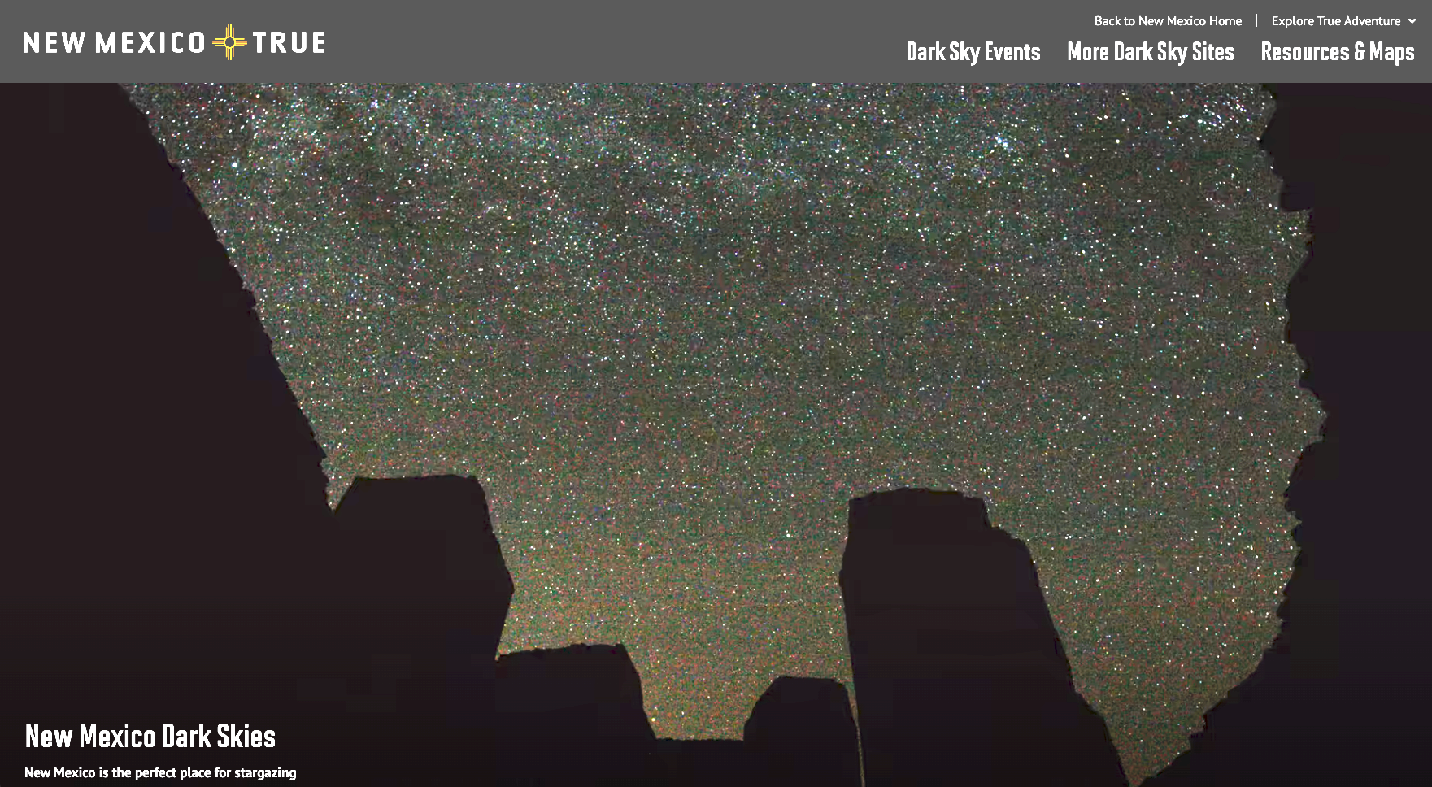
Tourism and economic impact
New Mexico True tourism campaign
Residential astronomical communities
Telescope hosting sites
Economic impact of universities and observatories
Star parties, etc

Slide 18
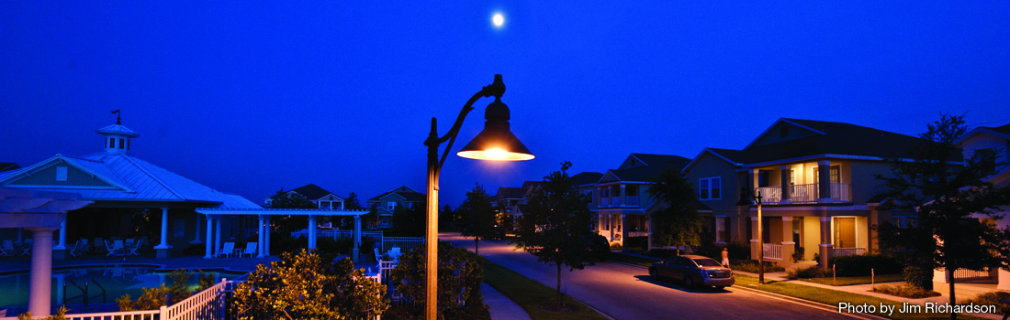
Light pollution is reversible!
Light pollution can be minimized and still allow for responsible lighting
Two organizations have been working on solutions:
Illuminating Engineering Society
DarkSky International

Slide 19
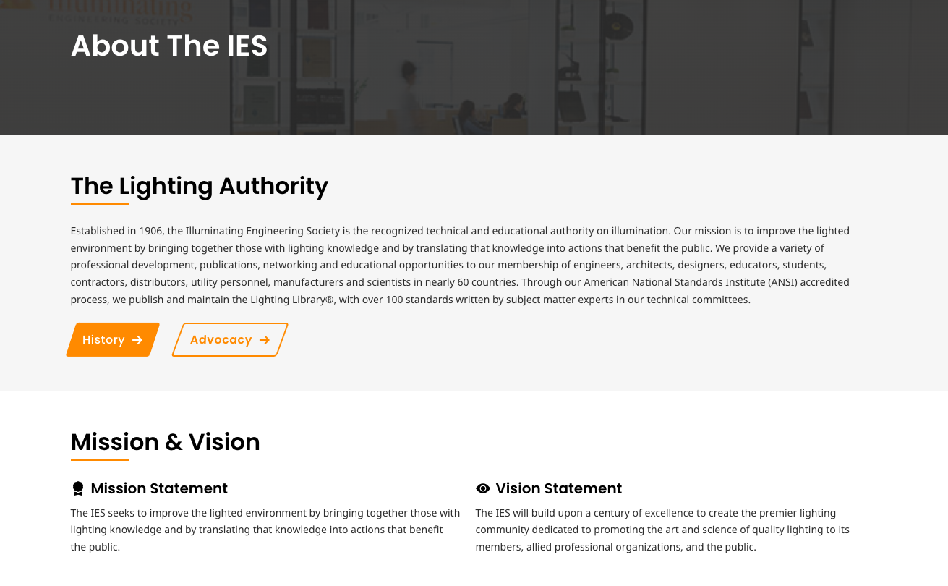
Illuminating Engineering Society

Slide 20
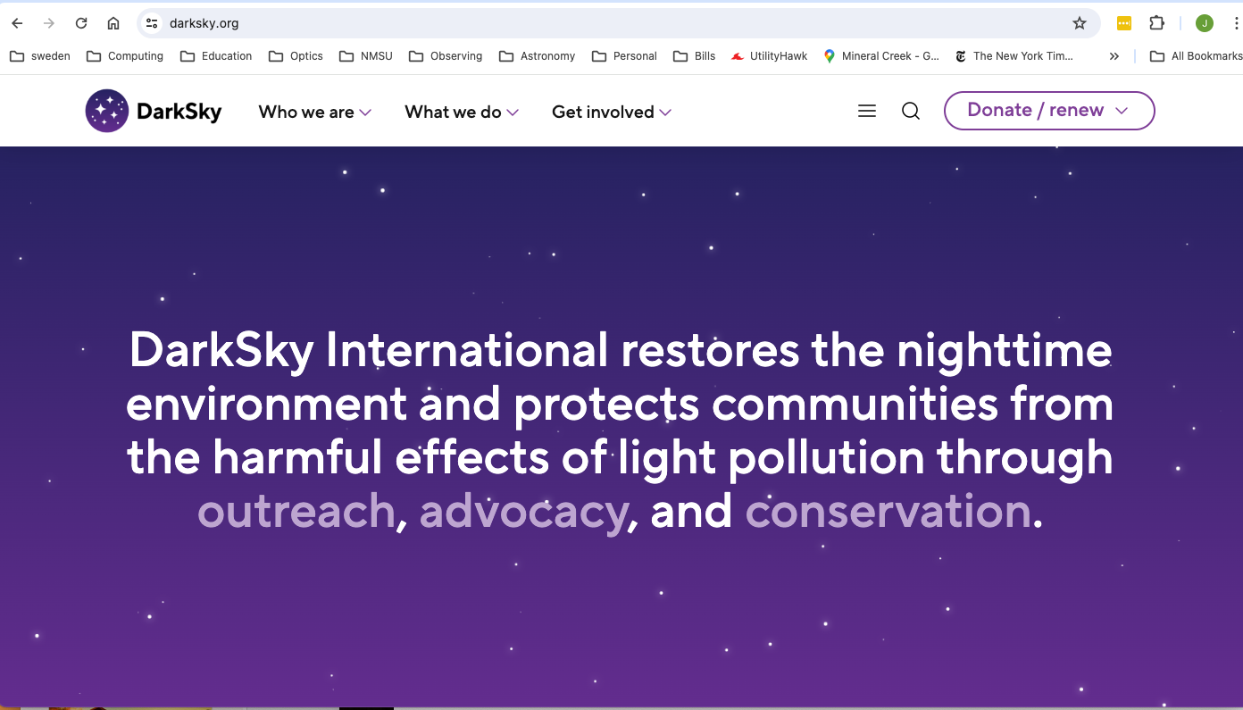
DarkSky International is a non-profit organization, based in Tucson, working worldwide to educate and effect change
Just last year, a New Mexico chapter of DarkSky International was formed, http://nmdarksky.org

Slide 21
Light pollution can be solved!
Light pollution can be minimized and still allow for responsible lighting
DarkSky International and the Illuminating Engineering Society have developed five basic principles of responsible outdoor lighting which, if followed, would go a long way towards improving and preserving out dark skies

Slide 22
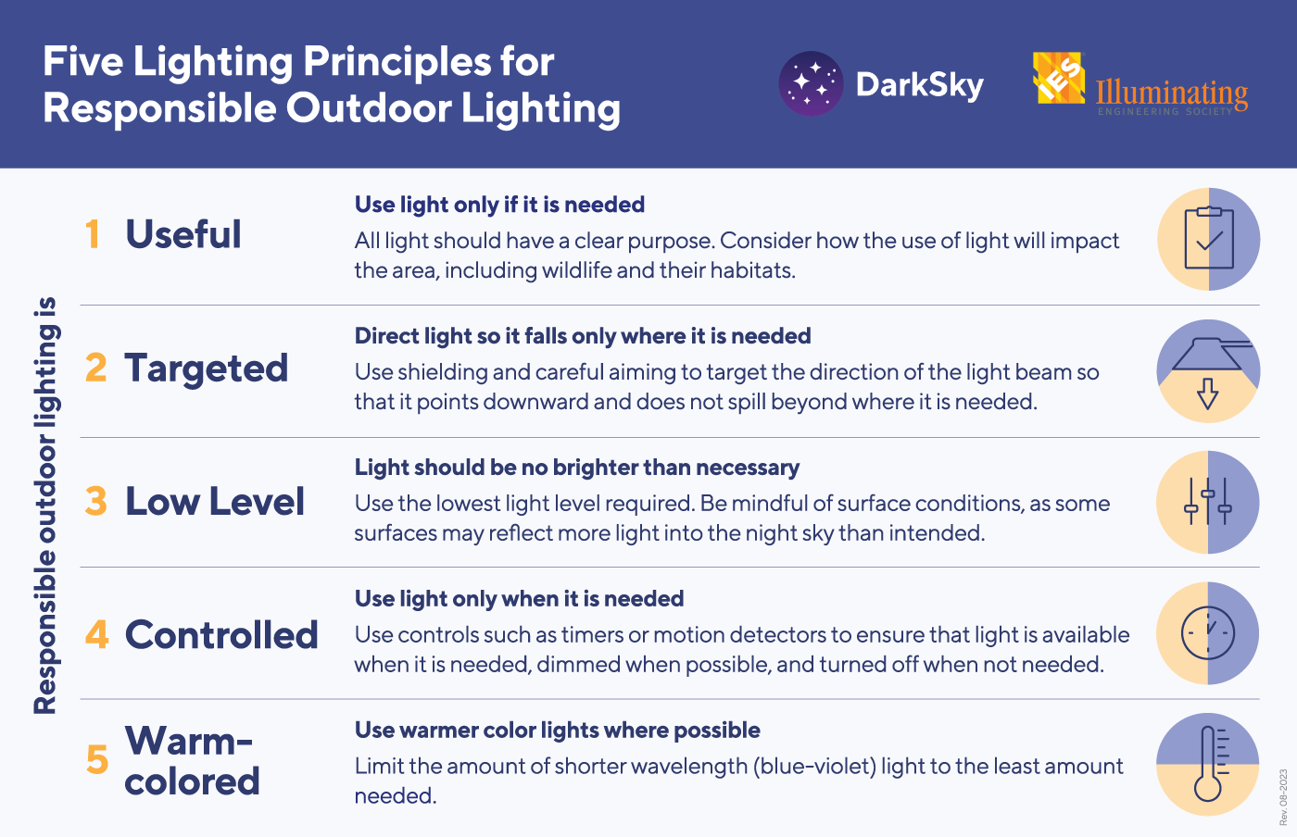
Notes:
The solutions are generally the same, whether you’re concerned about human health, safety/security, wildlife, energy conservation, or astronomy. And DarkSky International has condensed them down into these 5 principles of responsible outdoor lighting.
Useful - First decide if you really need the light. Is the lighting warranted?
If a light is there just to look pretty, perhaps turn it off and see pretty the natural night sky can be ☺

Slide 23
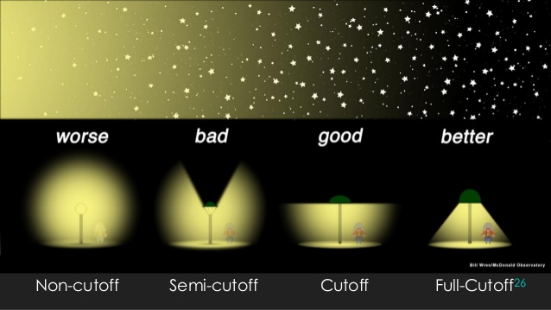
DarkSky International | 2024

Slide 24
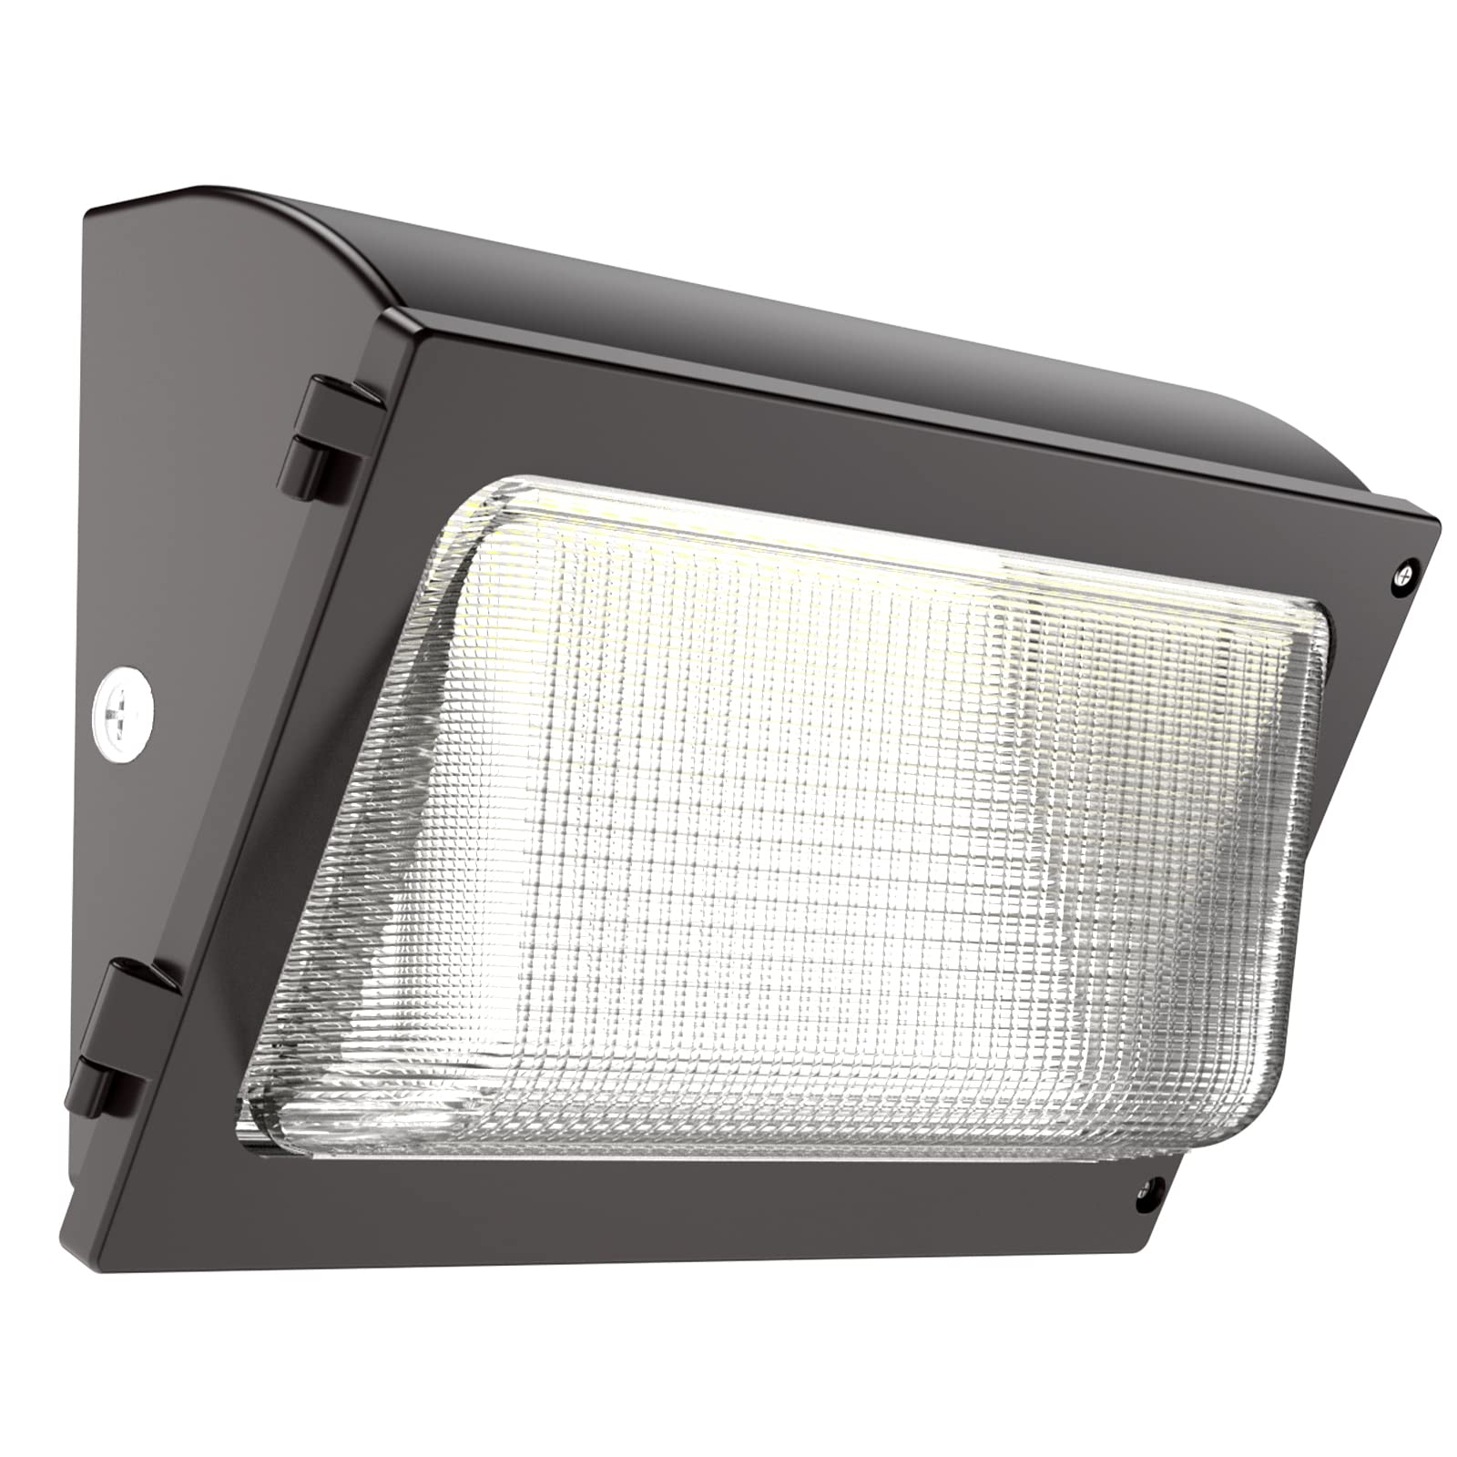
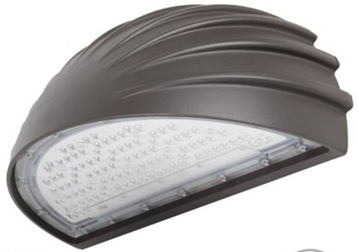
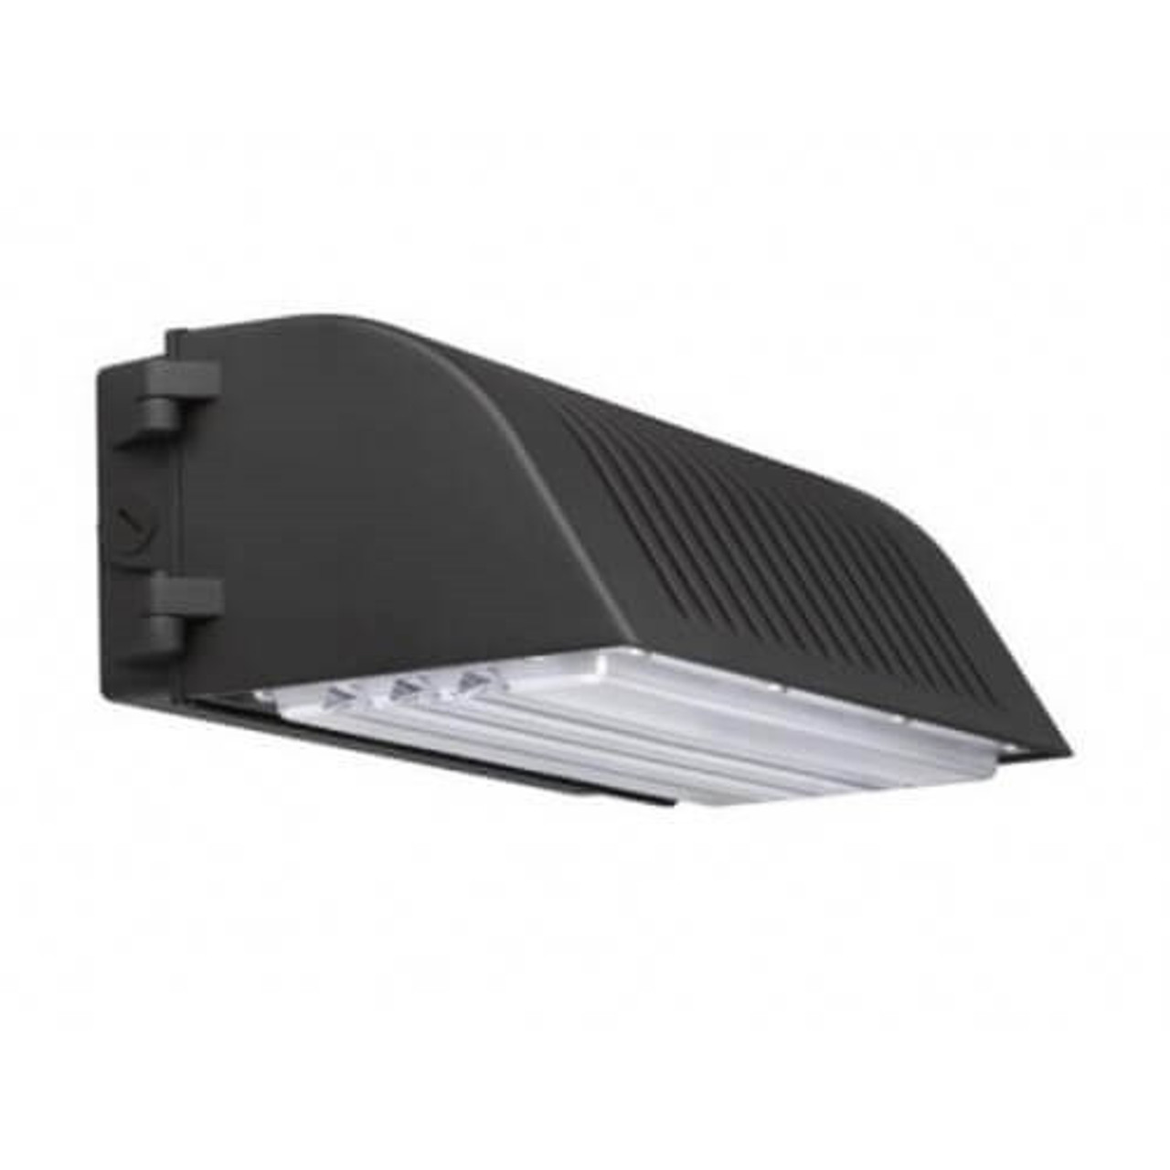
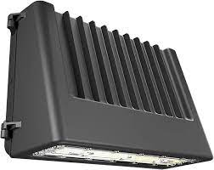
Fixtures and their proper usage are critical!
BAD
GOOD

Slide 25
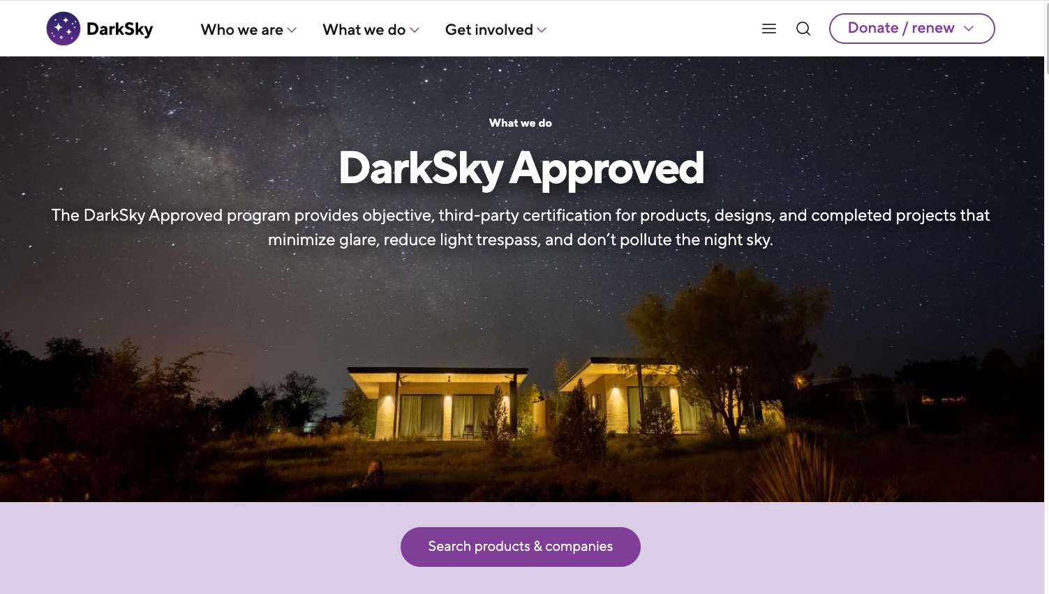
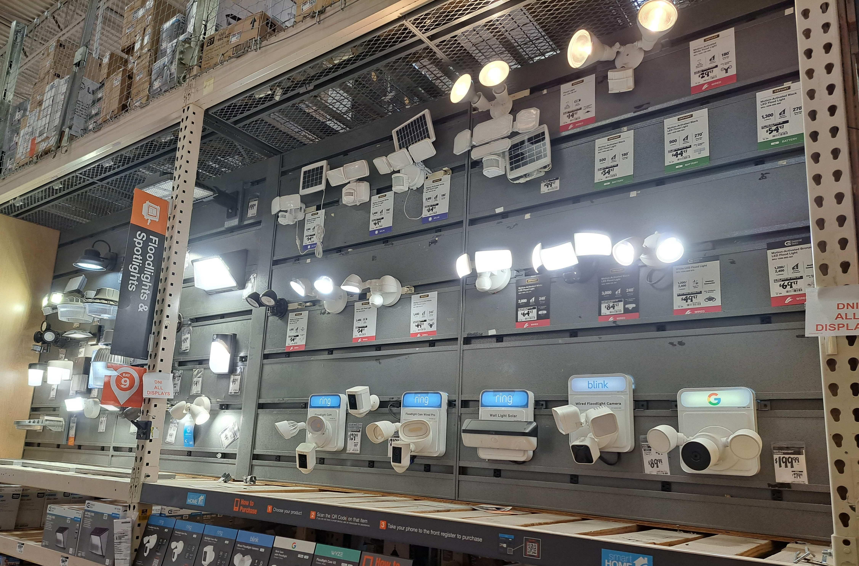
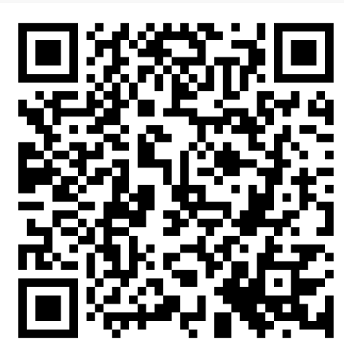
DarkSky Approved products
Use this :
Not this!
Request quality and compliant fixtures from your retailers!
Tell them you don’t want to pollute and trespass!
https://darksky.org/what-we-do/darksky-approved/
Notes:
https://darksky.org/what-we-do/darksky-approved/products-companies/

Slide 26
Keeping our skies darker is a win-win proposition!
Better for humans
Better for wildlife
Better for energy consumption
Better for budgets
Better for safety
Good for the economy
Put light only where and when it is needed!

Slide 27
What can we do?
Discuss, educate and communicate!
Follow good lighting practices at your homes
Use DarkSky approved products
Request retailers to carry and advertise them
Talk with your neighbors: concepts of glare and light trespass may be useful
New Mexico has a Night Sky Protection Act, established 1999, but it has not been especially effective
Efforts are underway to try to improve it, we will need input to legislators
Municipalities have lighting ordinances
Enforcement is typically a significant problem
Talk with municipal staff, legislators etc
Help to raise awareness, and communicate that you care
Voluntary compliance may be the most likely path towards success

Slide 28

What can we do?
Join DarkSky International (from $35/year), and you will be a member of the state chapter!
http://nmdarksky.org
Stay tuned for information about DarkSky events
Lights out for migration?
Visit DarkSky places and encourage others to do the same
Enjoy the night sky!
Raises awareness
New Mexico True : https://www.newmexico.org/darkskies/

Slide 29
Formally designated DarkSky places
DarkSky Sanctuary : public or private land that has an exceptional or distinguished quality of starry nights and a nocturnal environment that is protected for its scientific, natural, or educational value, its cultural heritage, and/or public enjoyment.
DarkSky Park: land possessing an exceptional or distinguished quality of starry nights and a nocturnal environment that is specifically protected for its scientific, natural, or educational value, its cultural heritage, and/or public enjoyment.
DarkSky Reserve: public or private land possessing an exceptional or distinguished quality of starry nights and nocturnal environment that is specifically protected for its scientific, natural, or educational value, its cultural heritage, and/or public enjoyment.
DarkSky Community: a town, city, municipality, or other legally organized community that has shown exceptional dedication to the preservation of the night sky through the implementation and enforcement of a quality outdoor lighting ordinance, dark sky education, and citizen support of dark skies.
Urban Night Sky Place: a municipal park, open space, observing site, or other similar property near or surrounded by large urban environs, and whose planning and design actively promote an authentic nighttime experience in the midst of significant artificial light.
Notes:
https://darksky.org/what-we-do/international-dark-sky-places/dark-sky-place-types/

Slide 30
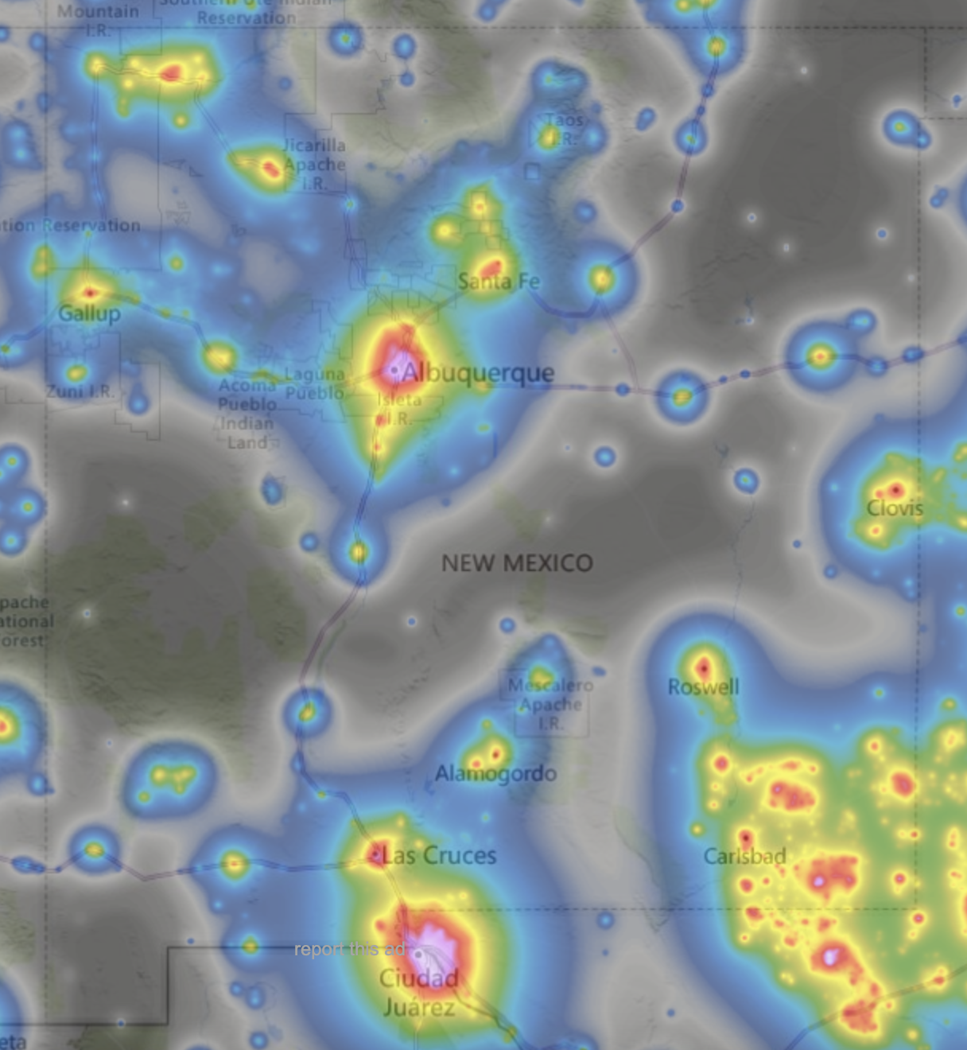
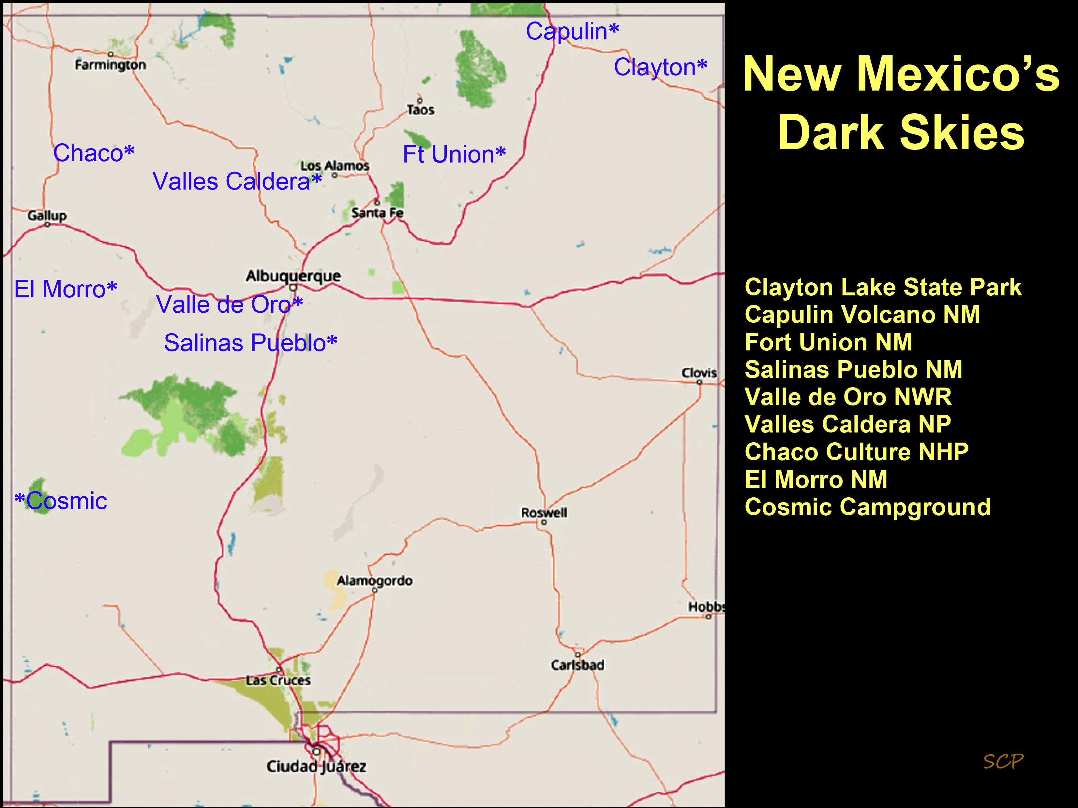
Official DarkSky locations in New Mexico
But light pollution is growing around the state….

Slide 31
Opportunities for more DarkSky places in NM
State parks
City of Rocks
Bluewater Lake
Leasburg
Oliver Lee
Bottomless lakes
Wilderness areas
Gila
Aldo Leopold
Dark corridors
Highway 60 corridor
Animas/Rodeo/Pelloncillos
How about a Gila / SW NM DarkSky Reserve?

Slide 32
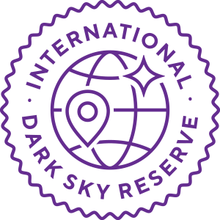
DarkSky Reserves
International Dark Sky Reserves
A combination of public or private lands of substantial size (at least 700 square kilometers, or about 173,000 acres) possessing an exceptional or distinguished quality of starry nights and nocturnal environment, and which is specifically protected for its scientific, natural, or educational value, its cultural heritage, and/or public enjoyment. The Reserve is formed through a partnership of landowners and/or administrators that recognize the value of the natural nighttime environment through regulations, formal agreements, and long-term planning.
The Reserve consists of two regions:
A “core” area meeting the minimum criteria for sky quality and natural darkness
A “peripheral” or “buffer” area that supports dark sky values in the core and receives similar benefits
Those entities interested in applying as a Reserve must identify the core and periphery areas in their inquiry, and must provide detailed maps showing the boundaries of these proposed areas. Inquiries that need additional guidance in selecting these areas and partners are encouraged to reach out to DarkSky Program staff with some preliminary suggestions as to where and how they want to build the Reserve.

Slide 33
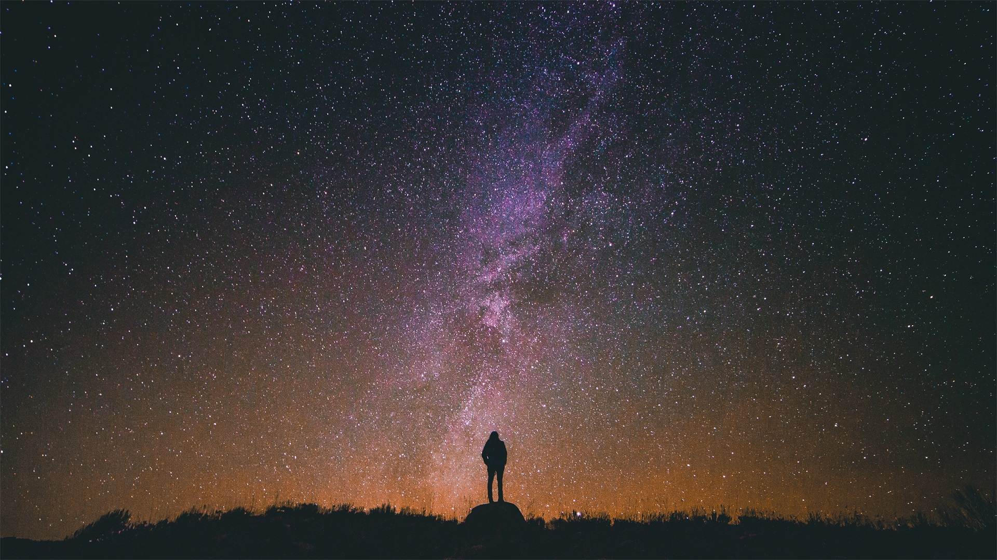
Dark Skies in New Mexico
Join the movement and help save the night!

Slide 34
NM DarkSky : chapter activities
Chapter formation / history / organization / membership
Chapter initiatives / committees
Legislation/ordinances
NSPA work
Local ordinance: Albuquerque, Santa Fe, Angel Fire, Taos, Las Cruces
Realize Las Cruces
Education/outreach/engagement
NMOGA
Tabling events, talks
Development of materials
ASLC help!
DarkSky places
New NM DarkSky places
Cosmic Campground
Economic impact
Economic impact report
Resources : nmdarksky.org web site

Slide 35
DarkSky Reserves
Eligibility criteria — Core
Management — May be publicly or privately owned, but the applicant must demonstrate how the site is legally protected.
Nighttime public access — The core must provide the opportunity for public nighttime access, with or without supervision. A portion of designated land may meet this requirement, or access may be available for a fraction of the length of the night.
Night sky quality — Cores are, by their nature, situated in proximity to gateway communities, which may impact areas of the core’s night sky quality. To meet DarkSky’s definition of dark skies, the core must demonstrate that the Milky Way is visible on a typical night. These conditions correspond approximately to a visual-band zenith luminance of 21.2 magnitudes per square arcsecond or greater and a naked eye limiting magnitude (NELM) of +6.
Location — The core zone boundaries must be drawn according to, and consistent with, the following principles:
A core area does not have a minimum area requirement but must provide sufficient area to meet the outreach and public access requirements described in the Guidelines.
The proposed core area boundary may take any shape and may follow logical or natural geographic features.
The core need not be a single, contiguous piece land; up to three cores may be defined, but this approach must be justified in the application document.
If the core includes a publicly protected area, such as a national or regional park, it must strive to fully encompass the boundaries of that area.
Resources — The core must be able and willing to commit to regular outreach efforts, external communications to educate both visitors and periphery communities about dark skies and light pollution, and meeting the 67%, 90%, and 100% lighting compliance rate timeline. It is strongly recommended for the Reserve to build a steering committee of key partners to organize efforts at the landscape scale.

Slide 36
DarkSky Reserves
Eligibility criteria — Periphery
Management — At least 80% of the total population and 80% of the land area within the proposed peripheral area must participate in the Reserve efforts. This includes communities; regional governmental areas such as counties, districts, and municipalities; and publicly and privately owned managed areas. Participation includes adopting a quality comprehensive Lighting Management Plan or Policy (LMP) that applies to all private and public landowners within the area of protection.
Nighttime public access — The emphasis for public access is focused on the dark core area, but other areas throughout the Reserve are welcome to encourage nighttime viewing experiences.
Night sky quality — There are no night sky requirements for the periphery. However, the Reserve should plan on monitoring night sky quality throughout the periphery to assess changes in this resource, especially with community participation to further protect the core area with its lighting choices.
Location — The peripheral zone boundaries must be drawn according to, and consistent with, the following principles:
The proposed peripheral zone boundary must be singular and contiguous, and must completely enclose the core zone. It may take any shape and may follow logical or natural geographic features.
The peripheral area (including the core) must encompass a minimum of 700 square kilometers (270 square miles or 173,000 acres), roughly equivalent to a circle of 15-km (9.3-mi) radius, or a land area sufficient to mitigate 80% of current and expected future light pollution threats to the core.
Large areas of open water, such as oceans, bays, and larger lakes, do not count toward the 700-square-kilometer / 80% requirement.
The boundaries of neither core nor periphery must be arbitrarily drawn to omit areas that would increase the difficulty of achieving the Reserve status, but must instead embrace these areas as an opportunity for improvement.
Resources — Participating communities must have a program, through education, economic incentives, permitting, or regulation, to encourage all new outdoor lighting fixtures to conform to the relevant regulation or guidelines for night sky friendly lighting.
Communities must have a number of examples of conforming lighting installations proportional to the size of the population they serve, both on roadways and on different private sites.
Those entities interested in applying as a Reserve must identify the core and periphery areas in their inquiry, and must provide detailed maps showing the boundaries of these proposed areas. Inquiries that need additional guidance in selecting these areas and partners are encouraged to reach out to DarkSky Program staff with some preliminary suggestions as to where and how they want to build the Reserve.

